Slide 1


Telecommunication
Electronic safety
R & D
Repair Lab
Power
Environmental
Quality and Audit
Managed Service
Portability
Site Construction
Commissionning
RAN
TX
Primary Energie (AC & Solar)
Civil Work
Backup (Battery &_{ Water &}
Solar)
Sanitation

Slide 2


Comet S.A PRESENTATION
L'excellence est notre passion
Senegalese company specialized in telecommunications sector covering Network Quality Assessment, Network Implementation (Towers, Civil Work, Power Systems, Air Cooling System) and consulting.
Twelve years presence in the telecoms sector
Major telecoms achievements in several countries (Senegal, Mali, Cape Verde, Guinea, Ivory Coast ...)
Recognized expertise and professionalism
50 permanent employee, managed by a top staff with more than 40 years of experience in the telecommunications sector
Privileged partner with institutions, telecoms operators, regulators and manufacturers (Alcatel, HUAWEI, Ericsson...)
COMET SA
Network Service integrator & Telecoms

Slide 3

PRESENTATION Comet S.A
L'excellence est notre passion
Engineering
Site Survey and Audit
Integration and Commissioning Services
Huawei
Civil Work and Sanitation
Installation and Integration of FH ,BTS (2G,3G,4G)
Public Service Delegated
Installation
LOS Survey
Detailled Pre-Project (DPP)
As Build
Site Interonnexion: GSM-FH-MW-Optical Fiber, BTS, FEEDERS
Ericsson RBS séries
Mini Link TN
Alcatel
Drive Test and Optimisation
Drive Tests
Benchmarking
Radio System Audit and correction
Turnkey Site construction (Rooftop and greenfield)
More than 400 sites built (Tigo, MTN and Orange)
Passive infrastructure rehabilitation
Turnkey building construction
Construction, Rehabilitation and commissioning of drilling
Civil Work
Backup Power Services (Rectifier, Battery Bank, Solar …)
In Charge Of Portability in Senegal
Managed Service Center and South Area for Tigo Network on behalf of Ericsson
In charge of Production and distribution of Water in Kaolack and Fatick (450 drillings)
Genset Installation and Commisssionning

Slide 4

PRESENTATION Comet S.A
L'excellence est notre passion
Network infrastructure and security systems
Integral building of telecom sites (passive and active infrastructure)
Deployment of Security systems: access management, intrusion detection, alarms, video surveillance, fire detection, ..
Energy and Environment: supply and installation
Maintenance and upgrade of sites
QoS/QoS Mobile Networks, Expertise and Training
Repair of telecommunications equipment
IBC Solution In Building Coverage
Development of applications and solutions
Number portability
Telecom Consulting and Expertise
Network Design, Audit, Optimization and Rollout

Slide 5
Comet S.A ORGANIZATION Chart
L'excellence est notre passion
CEO
Finance & Administration
CTO
Rollout & Operation
Civil Work
Electronique and Research
Engineering and Drive Test
Accountant & Finance
Power
RAN – Transmission
& Maintenance Support
Civil Work Engineering
Power Engineering
Electronic Engineering
Audit & Engineering Service
Internal Audit QSE, Finance
Field Service Operation
Field Service Operation
Field Service Operation
R&D
Field Service Operation
Logistic, Transit & Transport

Slide 6

Comet S.A – Some Of Our Main Achievement
L'excellence est notre passion
E2E INSTALLATION OF SITES (More than 400 sites)
INSTALLATION OF SPECIAL INFRASTRUCTURES (tree pylon, ...)
SITES UPGRADE WITH COMPLIANCE MAINTENANCE OF TELECOM SITES
Repair of telecom equipment (modules and radio cards, FAN BTS / Node B, etc.) More than 3000 Modules repaired
Implementation and Administration of Portability in Senegal, 2015
Managing Services on Tigo’s Network
Civil Work PM –
Souleymane NDIAYE
TI & TRM PM –
Abiboulaye DIOP
Drive Test PM – Abdou NDIAYE
6 Teams each include :
‐ TI /TX Technician
‐ Power
‐ 2 Riggers
3 Teams each include :
‐ Drive Test Technician
‐ Driver
3 Teams each included :
‐ Civil Work Engineer
‐ CW Technician

Slide 7






Comet S.A – Engineering
L'excellence est notre passion
  Solar Type Solution, hybride (Solar/Genset) or (Genset/Battery) or Solar Without Battey
Spectrum Audit 2G, 3G, 4G (scanning) and Interferences and Jamming detection
Network QoS Audit
Civil Work PM –
Souleymane NDIAYE
TI & TRM PM –
Abiboulaye DIOP
Drive Test PM – Abdou NDIAYE
  Tracking Software of RMA and Spares
  Monitoring and Supervision of Telecom sites
6 Teams each include :
‐ TI /TX Technician
‐ Power
‐ 2 Riggers
3 Teams each include :
‐ Drive Test Technician
‐ Driver
3 Teams each included :
‐ Civil Work Engineer
‐ CW Technician
New Site drive test, clusters, Strategic Road axis and Highway
Benchmark CRC

Slide 8
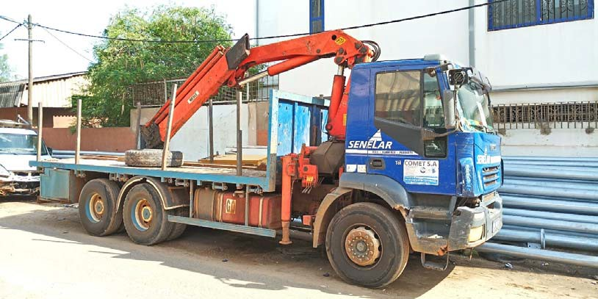
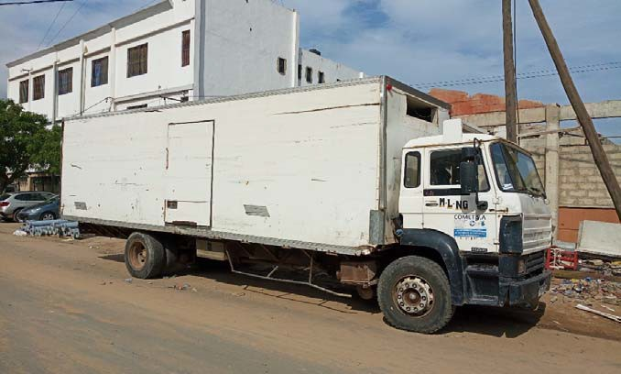
Logistic
L'excellence est notre passion
2 Cranes
4 Trucks for material transportation
15 Pick up
3 SUV for Drive Test 2G/3G/4G
5 Sites Master

Slide 9
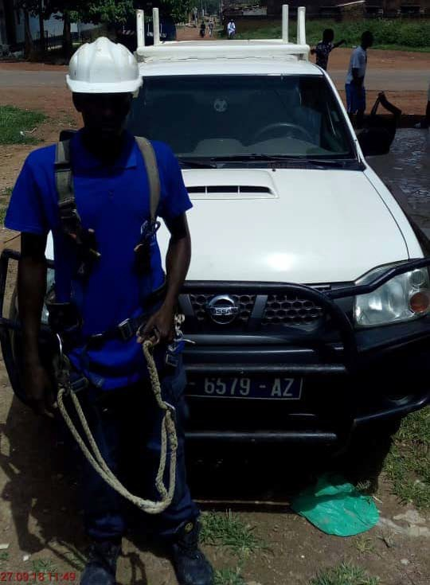
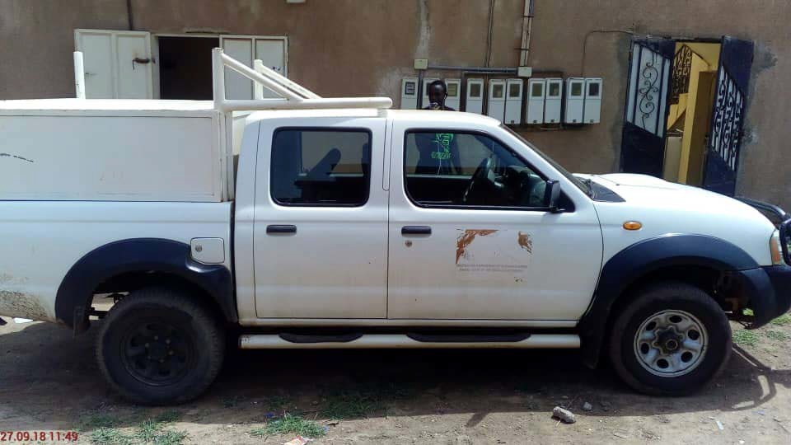
Logistic
L'excellence est notre passion

Slide 10
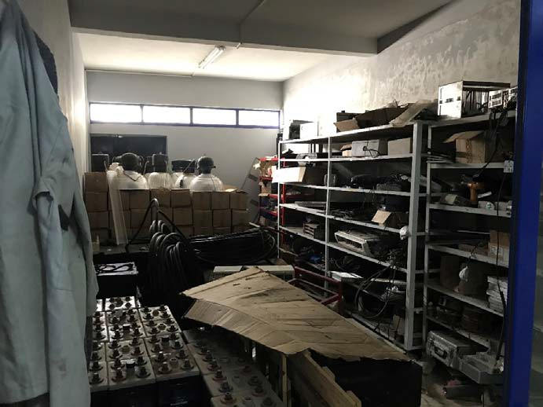
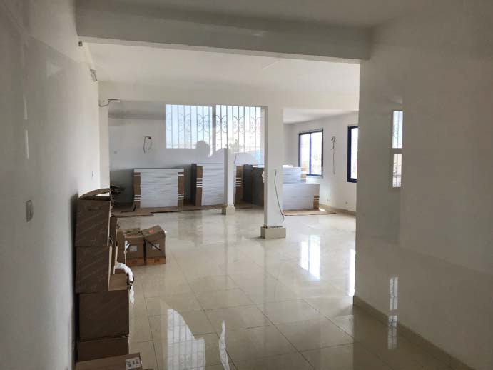
Warehouse
L'excellence est notre passion
Battery backup Storage
2nd Floor Warehouse (Solar panel, pump, etc …)

Slide 11
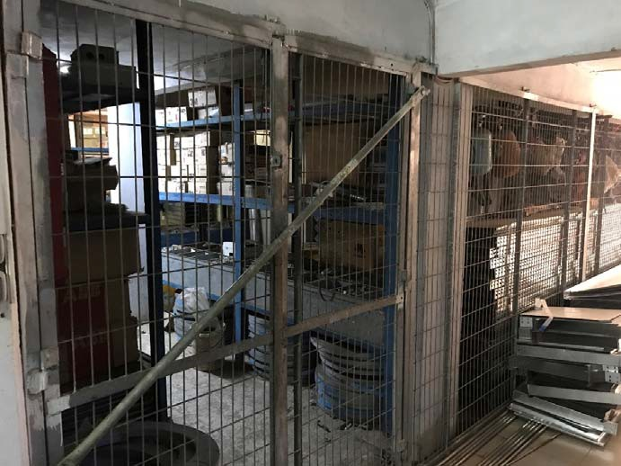
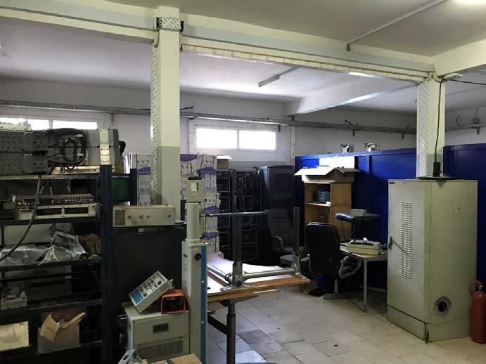
Warehouse
L'excellence est notre passion
Electric Equipment Storage
Radio Equipment Storage

Slide 12
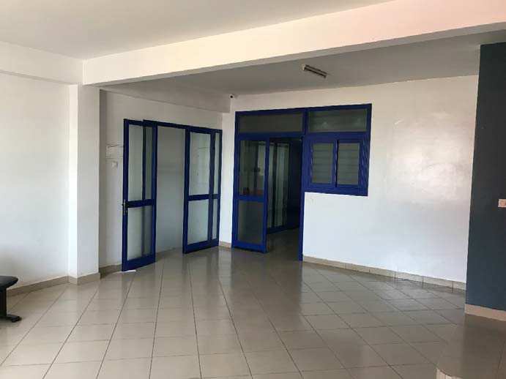
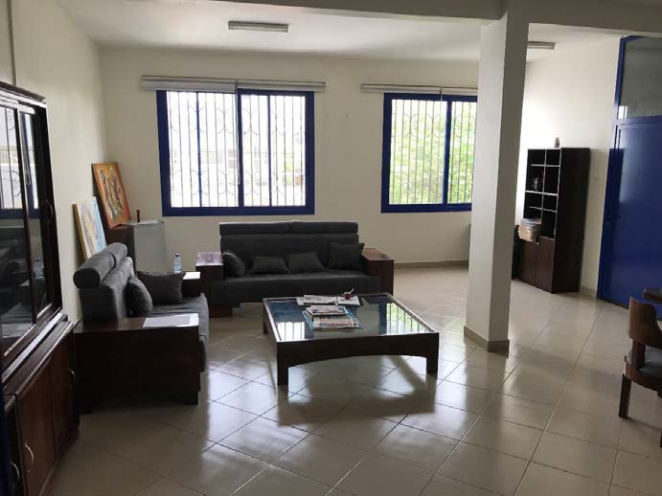
Office
L'excellence est notre passion
1st Floor Offices
Office

Slide 13
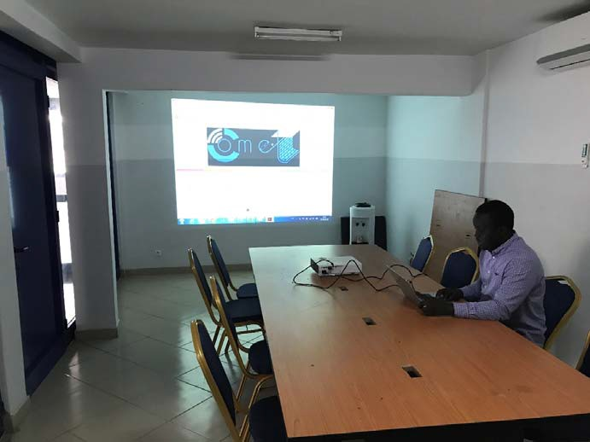
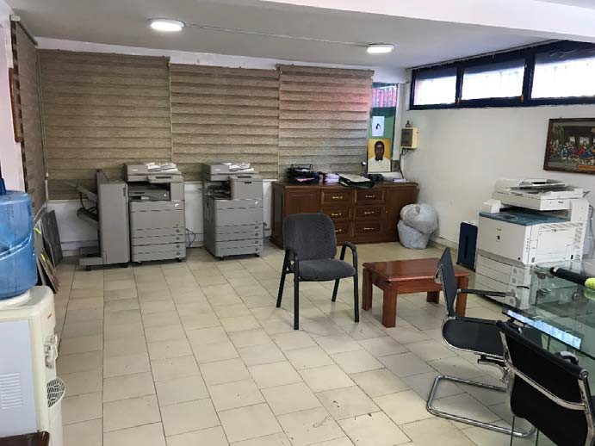
Office
L'excellence est notre passion
Meeting Room
CTO Office & Printers

Slide 14

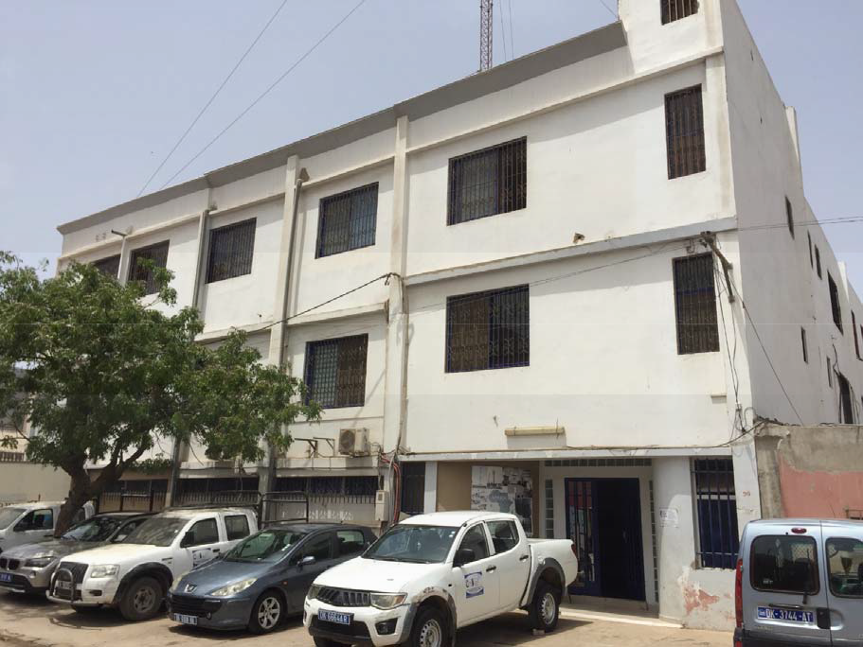

Comet S.A – Office and Warehouse
L'excellence est notre passion
Our office and WH
500sqm Office at Sodida
500sqm Warehouse at Sodida
500sqm Warehouse at Ben Tally
Comet S.A 2018
Construction de 400 sites Tigo

Slide 15
Drive Test Tools
L'excellence est notre passion
Devices & SW | Software Version | Quantity | Technology supported | Comments
TEMS Discovery Device | 11.1.4 | 1 | EVDO, GSM, WCDMA, LTE, WiMAX | Reporting & Post-Processing Tools
TEMS Pocket on Sony Xperia LT25i | 13.0.1 | 4 | 2G, 3G & 4G
TEMS Pocket on Sony Xperia Z5 (E6653) | 16.0.3 | 7 | 2G, 3G & 4G
TEMS Investigations | 15.3.6 | 2 | 2G & 3G
Handsets Sony Xperia Arc S |  | 9 | 2G & 3G
Audio Capturing Units (POLQA 4 Channels) |  | 2 |  | Licence POLQA for 10 channels on TEMS Investigations
TEMS Investigations | 14.2 | 1 | 2G & 3G
Handsets Sony W995 | N/A | 3 | HSPA/ WCDMA/ EDGE/ GSM | Support also Scan on 2G & 3G frequency (900/1800/2100)
Scanner PCTel SeeGull Ex+ | N/A | 1 | 2G (DL 900/1800)
 |  |  | 3G (DL 2100/900)
 |  |  | LTE
Scanner PCTel SeeGull Ex | N/A | 1 | 2G (DL 900/1800)
 |  |  | 3G (DL 2100/900)

Slide 16
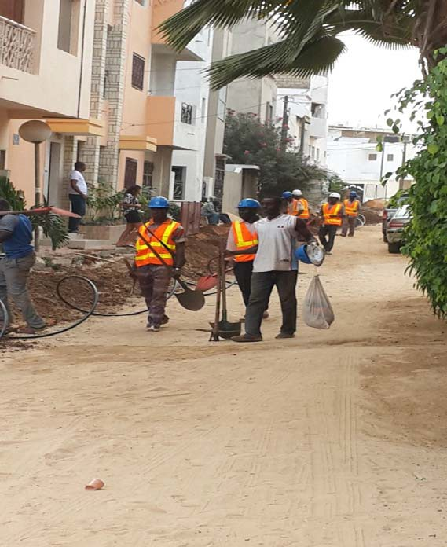
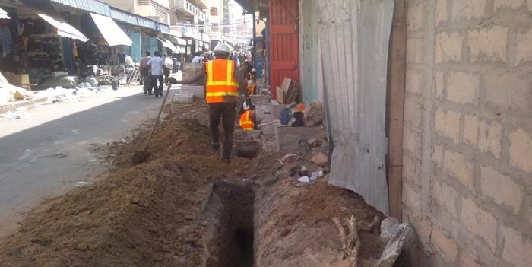
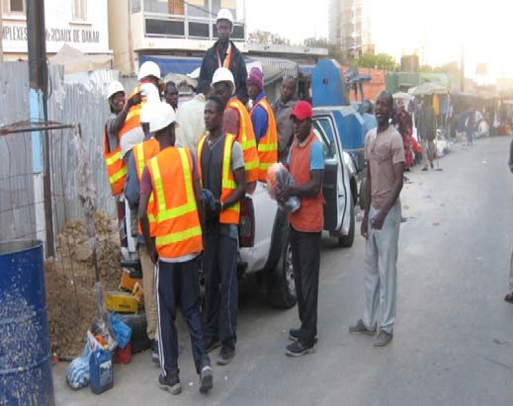
Comet S.A – Optical Fiber
L'excellence est notre passion
Civil Work PM –
Souleymane NDIAYE
TI & TRM PM –
Abiboulaye DIOP
Drive Test PM – Abdou NDIAYE
6 Teams each include :
‐ TI /TX Technician
‐ Power
‐ 2 Riggers
3 Teams each include :
‐ Drive Test Technician
‐ Driver
3 Teams each included :
‐ Civil Work Engineer
‐ CW Technician

Slide 17
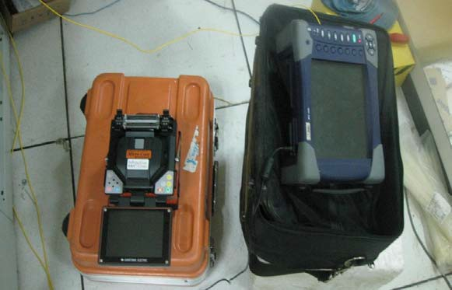
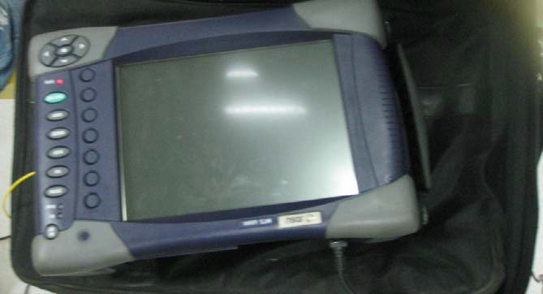
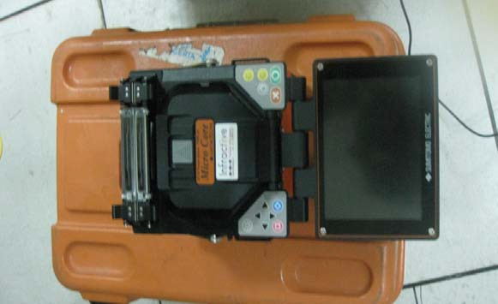
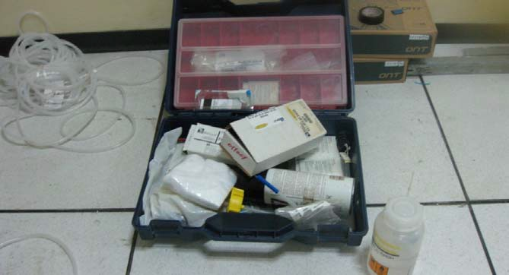
Comet S.A – Optical Fiber Tools
L'excellence est notre passion
Civil Work PM –
Souleymane NDIAYE
TI & TRM PM –
Abiboulaye DIOP
Drive Test PM – Abdou NDIAYE
6 Teams each include :
‐ TI /TX Technician
‐ Power
‐ 2 Riggers
3 Teams each include :
‐ Drive Test Technician
‐ Driver
3 Teams each included :
‐ Civil Work Engineer
‐ CW Technician

Slide 18
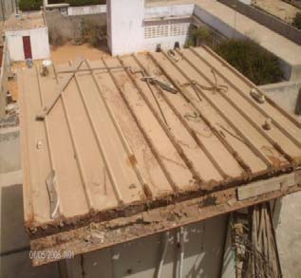
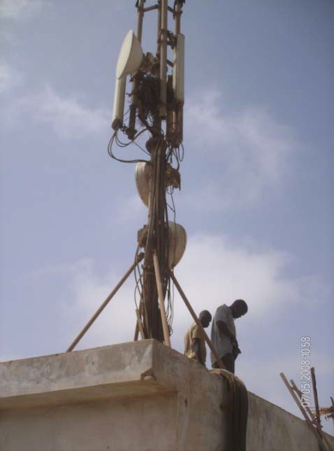
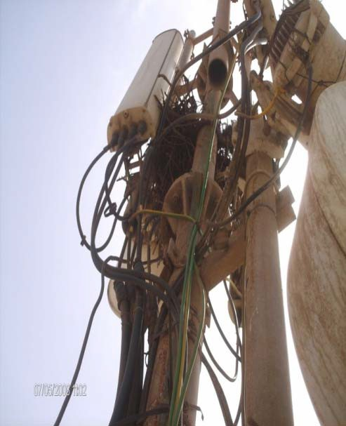
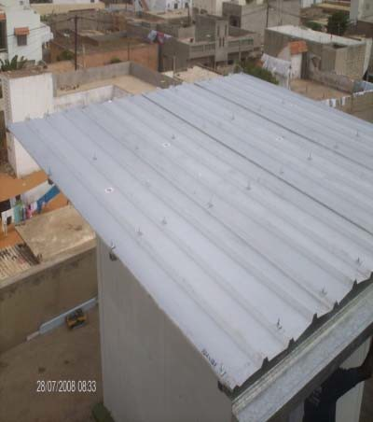
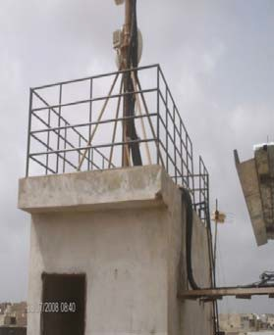
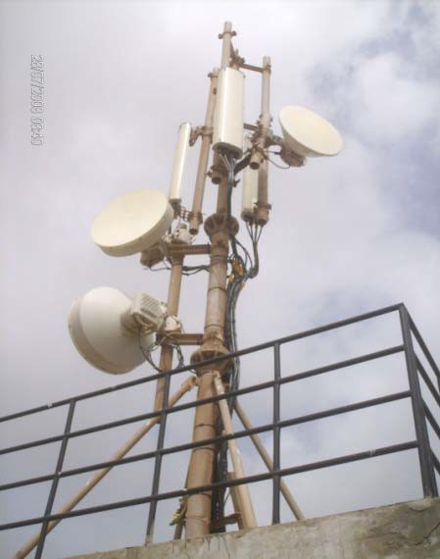
Comet S.A – Site Rehabilitation
L'excellence est notre passion
Civil Work PM –
Souleymane NDIAYE
TI & TRM PM –
Abiboulaye DIOP
Before
Drive Test PM – Abdou NDIAYE
6 Teams each include :
‐ TI /TX Technician
‐ Power
‐ 2 Riggers
3 Teams each include :
‐ Drive Test Technician
‐ Driver
3 Teams each included :
‐ Civil Work Engineer
‐ CW Technician
After

Slide 19
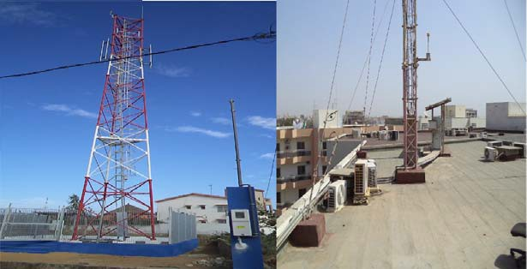
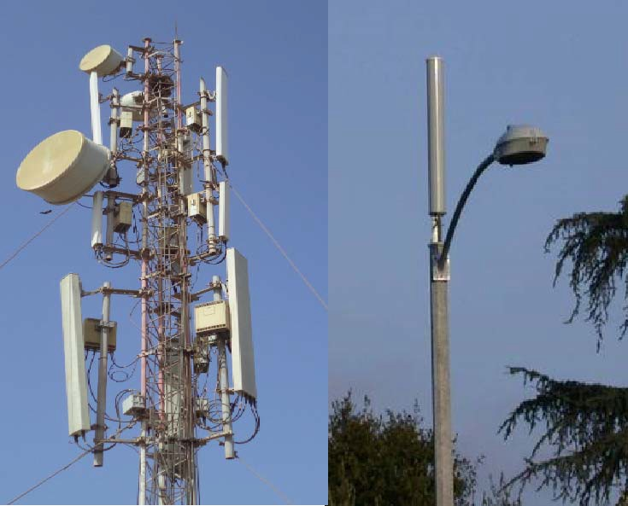
COMET S.A REFERENCES
L'excellence est notre passion
Self supported & Guyed tower
GSM antenna & MW

Slide 20
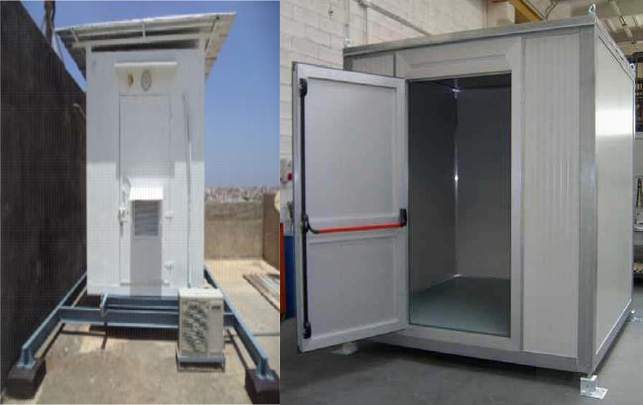
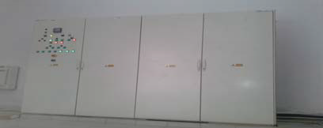
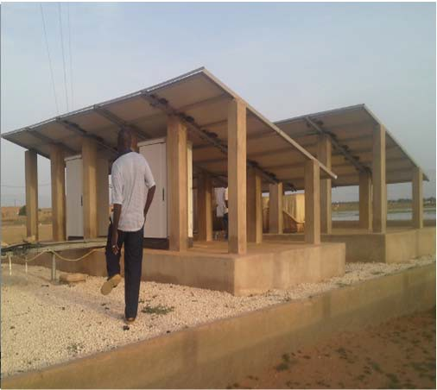
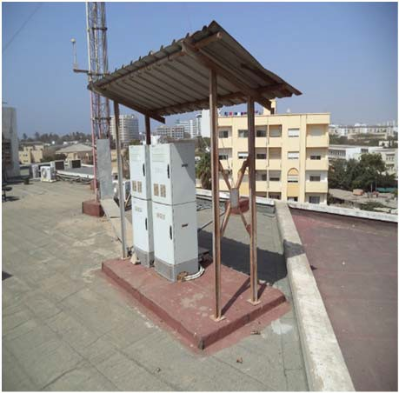
COMET S.A REFERENCES
L'excellence est notre passion
Shelter
Power (ACDB) and Solar site
Sites Outdoor

Slide 21
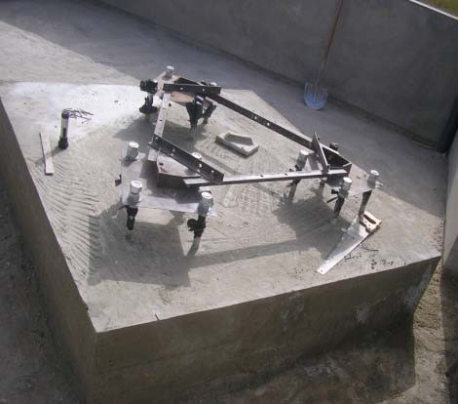
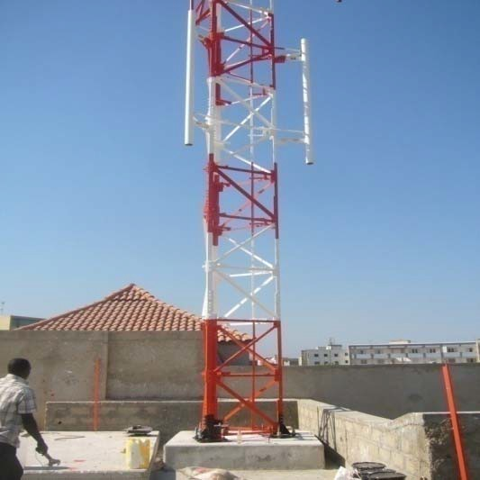
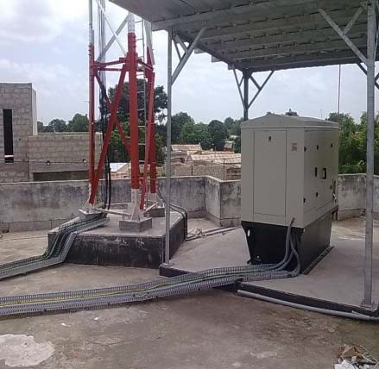
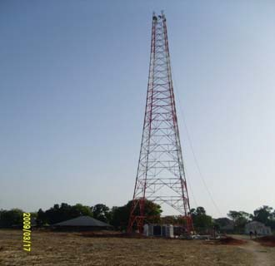
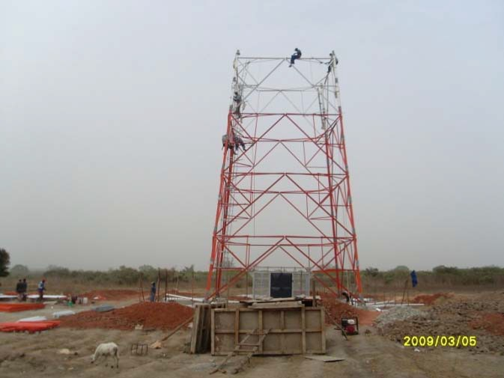
COMET S.A REFERENCES
L'excellence est notre passion
COMET
Turnkey site Construction
Site MTN BISSAU

Slide 22
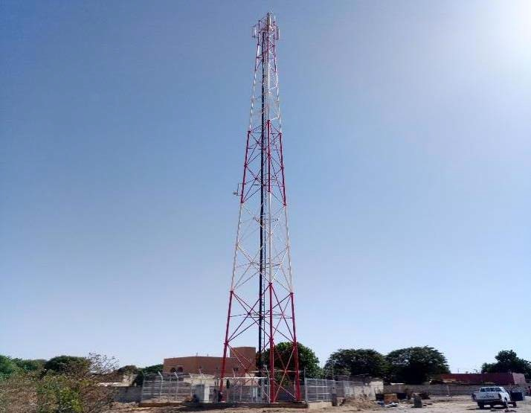
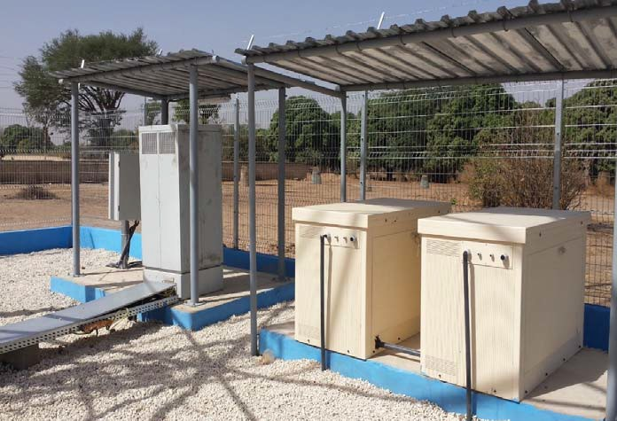
COMET S.A REFERENCES
L'excellence est notre passion
TURNKEY SITE SANGHE - TIGO
Comet S.A 2018

Slide 23
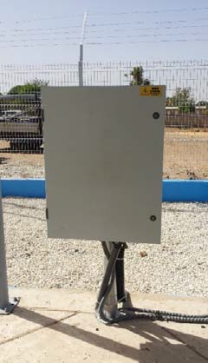
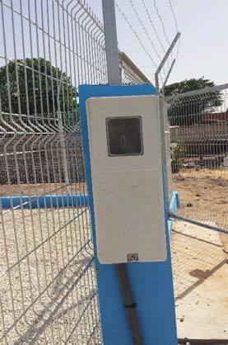
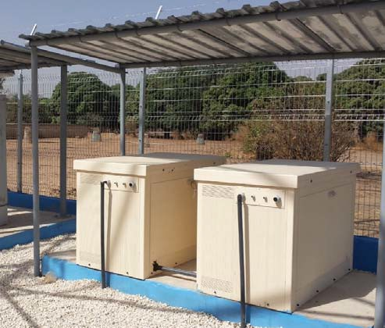

COMET S.A REFERENCES
L'excellence est notre passion
Primary power
Backup power
TURNKEY SITE SANGHE - TIGO
Comet S.A 2018

Slide 24





















Comet S.A PARTENAIRES
L'excellence est notre passion

